Slide 1
The Schmitt Trigger Circuit
By Megan Izzo

Slide 2
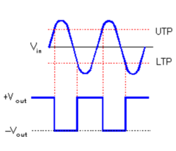
What is the Schmitt Trigger?
Schmitt comes from the last name of the scientist that invented it (Electrical4U, 2021, pa. 2). Trigger is part of the name because the input value can vary enough to trigger a change to the output (Electrical4U, 2021, pa. 6). The Schmitt Trigger is a comparator with hysteresis (Electronics For You, 2020, pa. 2). A comparator is used to compare voltages or currents of two signals and it outputs the stronger one (Abasolo, 2021, pa. 1). Hysteresis is a system’s condition being dependent on it’s history (Kuphaldt, 2015, pa. 1). Combining those two definitions together, tells what the Schmitt Trigger is used for.

Slide 3
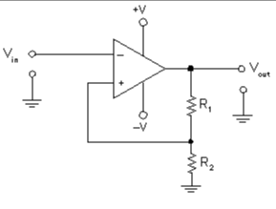
Purpose of the Schmitt Trigger
The purpose of the Schmitt Trigger is to get consistent values of signals by having two thresholds, an upper and a lower, to avoid unwanted interference in a signal (Introduction to Schmitt Trigger, 2019, pa. 1). When the input is bigger or smaller than the average output, then the Schmitt Trigger compensates by either lowering the thresholds or by putting them at a higher signal (Electrical4U, 2021, pa. 8).

Slide 4
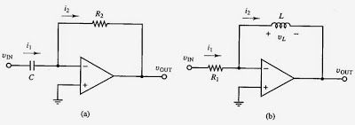
Advantages of the Schmitt Trigger
The Schmitt Trigger is very versatile (Prajapati, 2022, pa. 13). It can be used to eliminate noise in a signal, to make certain wave signals into square waves, and to apply an oscillator (Electrical4U, 2021, pa. 60). It can also amplify weak signals and waves, and it is cost-effective Prajapati, 2022, pa. 13).

Slide 5
Disadvantages of the Schmitt Trigger
The Schmitt Trigger isn’t perfect. The disadvantages of this circuit include potentially needing oscillations and the values of the components used in it need to be exact or it won’t work properly (Prajapati, 2022, pa. 14).

Slide 6
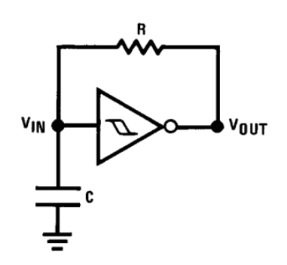
Variations of Schmitt Trigger?
As briefly covered in Advantages of the Schmitt Trigger, there are many uses for this to be included in circuits. Sine waves and triangular waves can be made into square waves which are more consistent in frequency and values. Noise is eliminated from signals (Electrical4U, 2021, pa. 60). Schmitt Triggers can also be used to act like expected oscillators to get frequent, expected outputs. Another use is to be used with switches to prevent glitches and unwanted transitions within the circuit (Introduction to Schmitt Trigger, 2019, pa. 15-19).

Slide 7
References
Abasolo, L. (2021, April 29). What Are Comparators? Circuit Basics. https://www.circuitbasics.com/what-are-comparators/
Electrical4U. (2021, February 12). Schmitt Trigger: What is it And How Does it Work? (Inverting & Non-Inverting Circuit Diagrams). Electrical4u.com. https://www.electrical4u.com/schmitt-trigger/
Introduction to Schmitt Trigger. (2019). Components101.
https://components101.com/articles/schmitt-trigger-introduction-working-applications
Kuphaldt, T. R. (2015, February 17). Hysteresis. Allaboutcircuits.com; All About Circuits. https://www.allaboutcircuits.com/textbook/semiconductors/chpt-7/hysteresis/
Prajapati, A. (2022, December 27). What is Schmitt Trigger Circuit, Definition, Pros & Cons. YourEngineer. https://yourengineer.in/knowledge-hub/what-is-s-t-circuit-definitions-advantages-disadvantages/
What Is A Schmitt Trigger? (2020, November 20). Electronics For You, NA.
https://link-gale-com.lapr1.idm.oclc.org/apps/doc/A642311686/ITOF?u=azstatelibdev&sid=bookmark-ITOF&xid=55ec7259

